Slide 1
The Silk Road
Ancient China

Slide 2
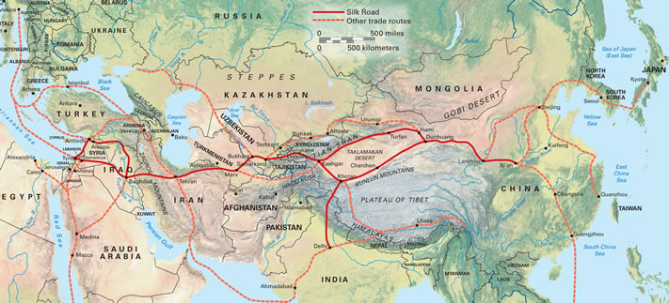

Slide 3
The Silk Road
The Silk Road carried Chinese goods as far as Greece and Rome.
Chinese and Arab merchants made lots of money doing this
For centuries, Chinese goods were very desirable in the west
The road was very expensive and difficult
Had to pay taxes to many kingdoms the roads crossed
Dangerous because there were lots of bandits

