Slide 1

The Roman Republic
Chapter 8
Section 2

Slide 2
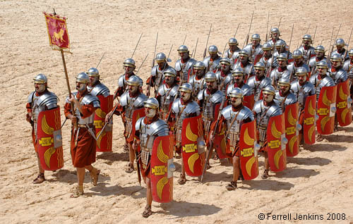
The Roman Republic
The Republic becomes powerful = the army.
Like the Spartans every male citizen who owned land, served in the army.
Roman generals organized
Soldiers into legions.
Each legionaire carried
a short sword, a gladius,
a spear and shield

Slide 3

The Republic thrives -
Shrewd Rulers
Those conquered could be citizens.
An enemy becomes a friend.
Roads were built to allow troop movements when necesary
Follow the Roman rules, pay your taxes, or be destroyed.

Slide 4
Rome’s Government
Early Romans were divided into two classes:
Plebeians-
artisans, shopkeepers,
owners of small farms
**had less social status
**lacked important political right
**marriage between the two was forbidden
**only Patricians could serve in government
Patricians-
Wealthy landowners
**Both types of men were Roman citizens
  **Had right to vote , responsibility to pay taxes, and
**Serve in army

Slide 5
How Did Rome’s Government Work?
Consuls
Praetors
Lawmaking Body-
SENATE
Assembly of Centuries

Slide 6
How Did Rome’s Government work?
Consuls
Chosen every year
Praetors
interpret the law
Senate
Assembly of Centuries
select group of 300 patrician men, serve for life-propose laws, hold debates and approve building programs
Elected important officials, passed laws, was under control of the patricians
Headed up the army
act as judges
keeping tax records
handling public finance
ran government

Slide 7
Plebeians take action
They complained about having so little power in the Roman Republic .
In 494 B.C. many of them went on strike by: 1. refusing to serve in army
2. leaving to start republic of their own
IT WORKED!
In 471 B.C. they were allowed to set up own body of representatives called the Council of the Plebs.
In 455 B.C. plebeians and patricians were allowed to marry
By 300 B.C. they were allowed to become consuls

Slide 8
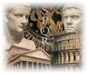

Roman Republic becomes more representative…
In 287 B.C. the Council of the Plebs gained the power to pass laws for ALL Romans.
All male citizens had equal political standing
Women still remained without a voice in the government

Slide 9
The Twelve Tables
Rome‘s first code of law.
The laws were carved on bronze tablets that was placed in the Forum (Rome’s marketplace)
A principle was established: that all free citizens had the right to be treated equally by the legal system.
Only applied to Roman citizens

Slide 10
Gift to the World - Law of Nations
Collection of laws for ALL stating principles of justice that applied to people everywhere…
Innocent until proven guilty
People accused of crimes could defend themselves before a judge
Judge has to look at evidence before making a decision
EVEN
TODAY

Slide 11
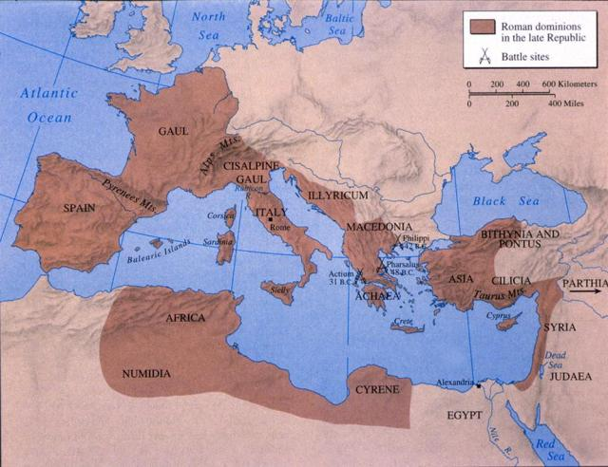
The Roman Republic

