Slide 1
The Geography of Egypt

Slide 2
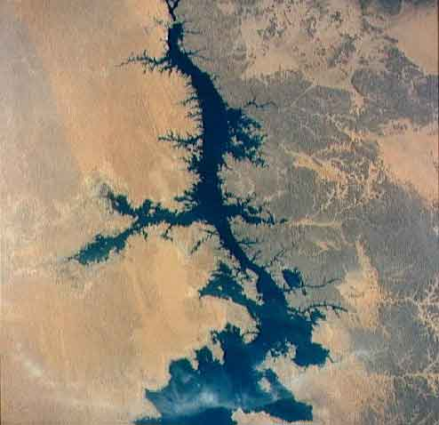
The Nile
The Nile: Egyptians relied on it for water.
Provides water
Used for cooking, cleaning, bathing, and drinking
Provides fish and supports plants and animals
Longest river in the world

Slide 3
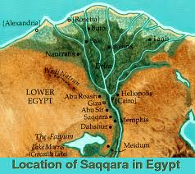
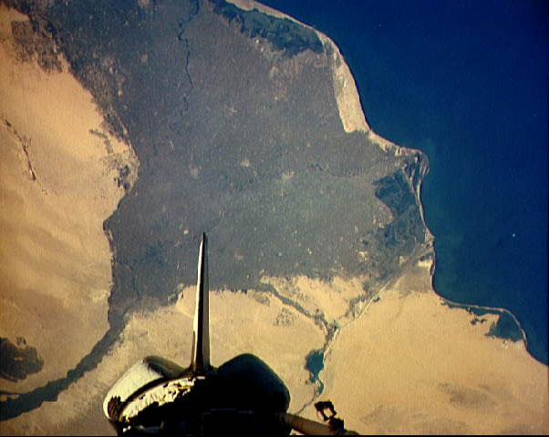
The Nile Delta
Satellite image
The river fans out as it reaches the sea creating a delta.
Creates a large area of fertile soil for growing crops

Slide 4
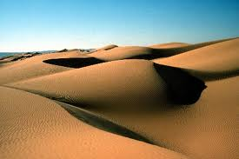
The Sahara Desert
The Sahara is the largest desert in the world.
Want to try and walk across this?
Invading army?

Slide 5
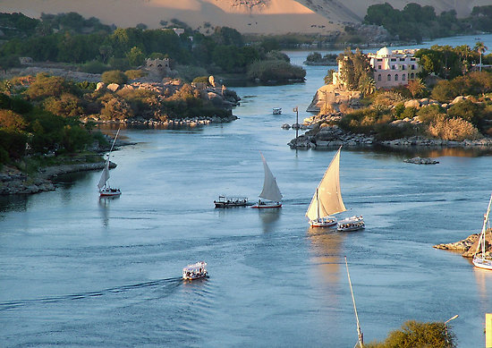
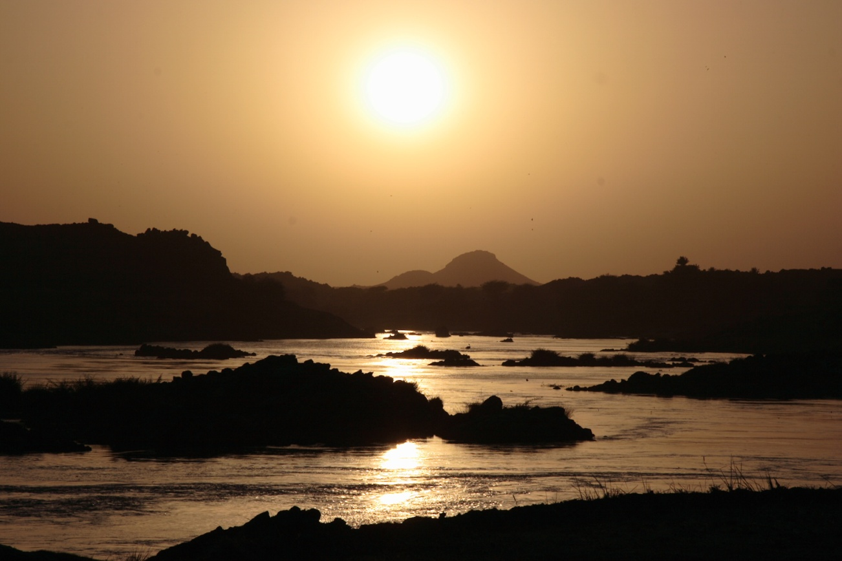
The cataracts in Southern Egypt
Cataracts: an area of
narrow cliffs and
boulders that
create wild rapids.
Can an invading army get
large ships through
these passages?

Slide 6
Natural Barriers
Egypt was well protected from invaders
Delta to the North
Deserts to the East and West
Cataracts to the South
This made it hard to attack!!!!!!!!!!

Slide 7
Uses of the Nile
Flooding was dependable and gentle
Brought fresh soil
Destroying homes and crops not as much of a concern as in Mesopotamia
Planted barley, wheat, flax seeds
Masters of irrigation
Dug basins, canals, dikes, and flood walls

Slide 8
Papyrus
Papyrus: reed plant that grew along the shores of the Nile
Used to make baskets, sandals, and rafts
Later used as paper

Slide 9
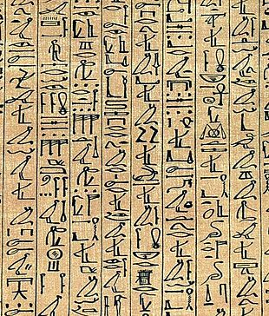
Hieroglyphics
Egyptian writing system using pictures
Carved into stone walls and monuments
Written on papyrus for everyday uses
Only boys could be scribes and attend scribe school

