Slide 1
Israel and Judaism
Later Mesopotamian Empires

Slide 2
Israel’s History
Jews trace their history to Abraham
Important figure in Judaism, Islam, and Christianity
He made covenant (or agreement) with God
Out of him the Jewish people were born
According to the Bible, because of drought, Jews forced to move to Egypt
Eventually became slaves, but led to freedom by Moses
Return to the land of Abraham and settle

Slide 3
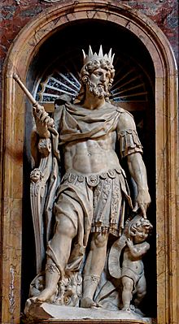
Israel’s History
Kingdom of Israel reaches the height of its power under David and his son Solomon
Under King David Israel defeats its enemies and becomes and empire – rules several other nations
Several books in the Hebrew Bible include details about his ruling. He also penned many of the psalms.

Slide 4
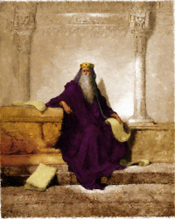
Israel’s History
Israel enjoyed its greatest wealth under Solomon
He wrote several of the books in the Hebrew Bible: Proverbs, Songs of Solomon, Ecclesiastes

Slide 5
Israel’s History
After Solomon’s death, Israel is no longer united
The Assyrians defeat the Jews and take over
Soon the Assyrians lose power and the Chaldeans under King Nebuchadnezzar take over.
After King Nebuchadnezzar dies, the Persians take over

Slide 6
Judaism
Jews believe in one God. They are monotheistic. Most religions at the time are polytheistic.
Believe in the Hebrew Bible (Old Testament to Christians)
Jews are waiting for a messiah or deliverer (savior) sent by God
According to their faith, God helps the Jews at various points in their history
To remember this, the Jews celebrate holidays

Slide 7
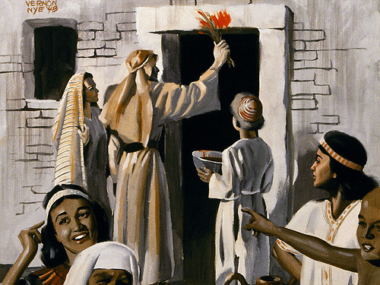
Jewish Holidays
Passover
Celebrates God’s passing over of the Jews during the final plague in Egypt

Slide 8
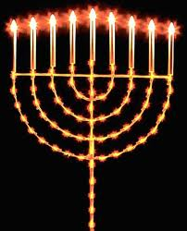
Jewish Holidays
Rosh Hoshana: Celebrates the Jewish New Year
Yom Kippur: To make amends for sins of the past year
Hanukkah: To celebrate the Maccabee’s victory reclaiming the temple

