Slide 1
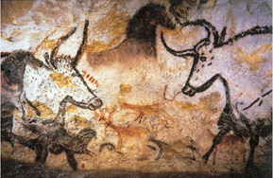
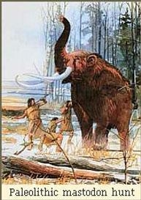
Early People
Journey Across Time
Ch1: The First Civilizations

Slide 2
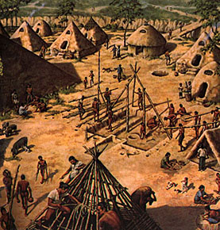
Enduring Understanding:
Humans made great advances from the Paleolithic Age to the Neolithic Age.

Slide 3
Places, People, &Vocabulary:
Paleolithic Age (Old)
Neolithic Age (New)
Ice Age
Specialization
Hunter-gatherers
Civilization

Slide 4
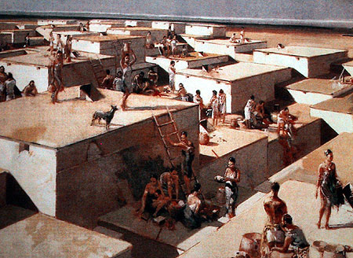
Places, People, &Vocabulary:
Technology
Domesticate
Nomads
Catal Huyuk
Jericho
Agriculture
Irrigation

Slide 5
What do you want to know?
Think about it, use your book if you’d like, and write down one question in your ISN.
Turn to the person next to you and share! ☺

Slide 6
Paleolithic –Old Stone Age
People were Hunter Gatherers
Hunter: fish, animals, insects
Gathers: berries, grain, fruits
Nomads: people that moved from place to place and followed food.
Men were the hunters
Used clubs to drive animals off of cliffs
Also had spears, traps, bow and arrows
Women were the gathers

Slide 7
Paleolithic – Old Stone Age
Discovered Fire
Food lasts longer, tastes better!!
Provides warmth
Protection from animals

Slide 8
Paleolithic – Old Stone Age
Inventions
Developed spoken languages
Furs
Changes in diet
Stronger shoes
Art
Crushed rocks
Powder, paint
Cave paintings

Slide 9
Paleolithic- Old Stone Age
Tools invented
Flint (hard stone used for starting fires)
Hand axes
Hunting spears
Fishing hooks
Needles from bones
Nets
Baskets
clothing

Slide 10
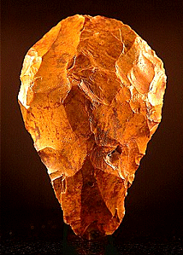
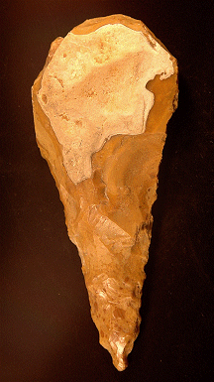
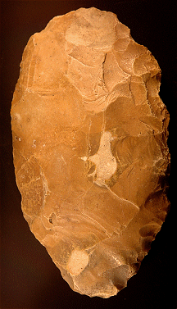
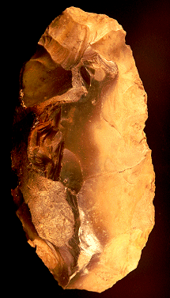
Paleolithic Tools
Flint ovates
Hand axes

Slide 11
Neolithic – New Stone Age
People began to change
Domesticate (tame) animals
Provide meat and meat
Wool
Pulled carts
Carried goods

Slide 12
Neolithic – New Stone Age
The Farming Revolution
Some consider this the most important event in human history.
Actually started all over the world at the same time
Different places grew different crops
Asia: barley, wheat, rice, soybeans, millet
Mexico: corn, squash, potatoes
Africa: millet, sorghum
Led to the development of agriculture as a way of life

Slide 13
Neolithic – New Stone Age
Herders still nomadic to find grazing
Farmers stayed close to home and settled
Villages started in Europe, India, Egypt, china Mexico
Oldest community – Jericho BC Middle East and Catel Hujok – Turkey

Slide 14
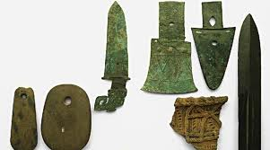
Neolithic – New Stone Age
With the development of agriculture, people grew more than what they needed. Not everyone needed to grow food now.
This led to specialization: different kinds of jobs
Now can create pottery to store food
Plant fibers can make mats
Better tools created
Copper then bronze

Slide 15
Key Concepts to Discuss and Consider as You Review
In the Old Stone Age people adapted to their environment and invented many tools
Development of technology; specialization (division of labor)
In the New Stone Age people started building communities.
Domestication and farming
Move from nomadic lifestyle to civilization; components of civilization/culture

