Slide 1
Chapter 8
Technology Tools and Resources for Inquiry Science

Slide 2
Questions to Ask Yourself
How does educational technology fit within the broader context of inquiry and constructivist learning of science?
What internet sites, telecommunications resources, commercial instructional software, and data collection and analysis tools are available to enhance the teaching and learning of inquiry science in your classroom?
How should the hardware and software available in our classroom be managed?
How can you stay on the cutting edge of learning technology throughout your teaching career?

Slide 3
The Internet as a Technology Resource
Use internet images to engage students into inquiry.
Used archived data.
Explore space
Take a virtual field trip
Visit online science exhibits
Tour a factory via the net.
Big problem with internet resources becoming unavailable.

Slide 4
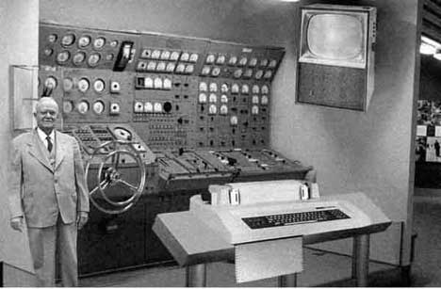

Slide 6
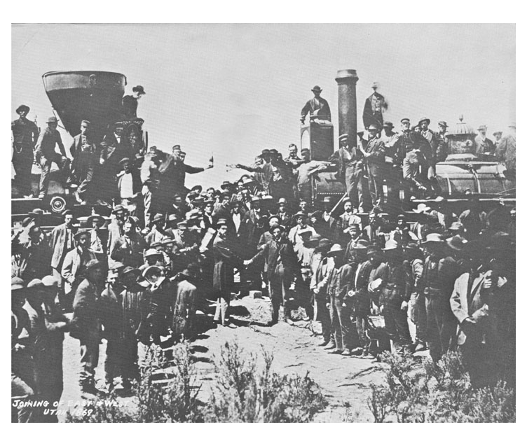

Slide 7
Use Instructional Software Packages
Many programs come with a variety of CDs to enhance your instruction.
More and more textbooks are also available online. Some of these even have tutorials.
Use of digital cameras, flip cameras, and digital microscopes.
How do you get these?
Apply for funds through PTSA
Apply for a grant

Slide 8
Using Software and Instructional Packages
Contribute to and use regional databases.
Participate in the Globe Project
Collect Observational Data on Clouds
Go through NASA
Use archived data to discover weather patterns

Slide 9
Other Technology Uses
Used computer-based laboratories to collect data.
Use spreadsheets to organize and collect data
Communicate through multimedia presentations.

Slide 10
Managing Educational Technology in the Science Classroom
This is a good question to ask in an interview. What kind of technology will I have access to?
One computer classroom
How will you use?
Multi-computer classrooms?
How will you use?
Set up your class?
Schoolwide computer lab

Slide 11
Selecting Software and Internet Sites
When students are online you are ultimately responsible.
Schools do have filters, but many students are savvy enough to find their way around them.
Find some kid friendly websites.
Teach them how to narrow searches.
Internet User Agreement

